Slide 1



Department of Electronics and Communication Engineering
S13BPT1-PROFESSIONAL TRAINING-I
LAPTOP SALES AND SERVICE WEBSITE
M Hariharan -43130134
Jagadeswaran A-43130157
A3

Slide 2
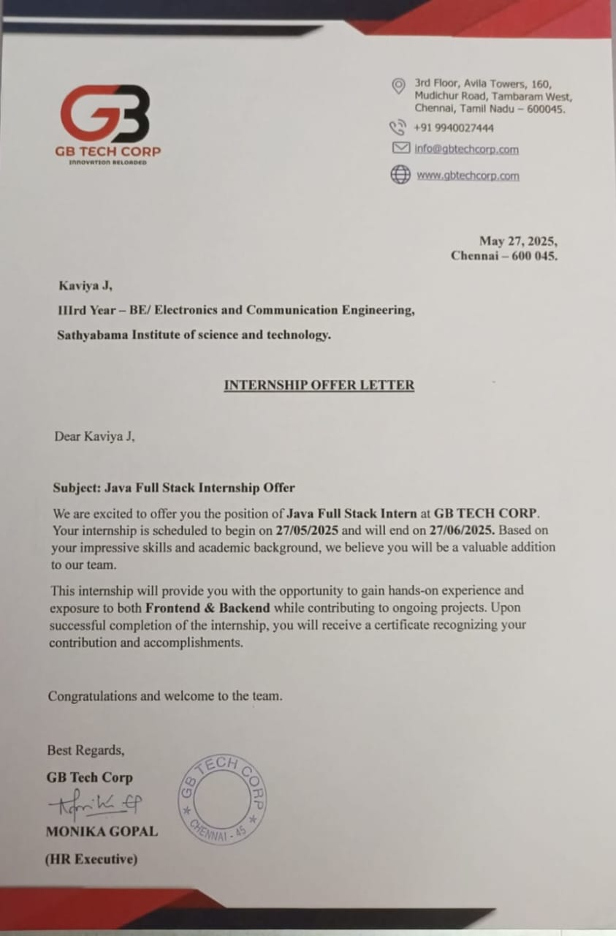
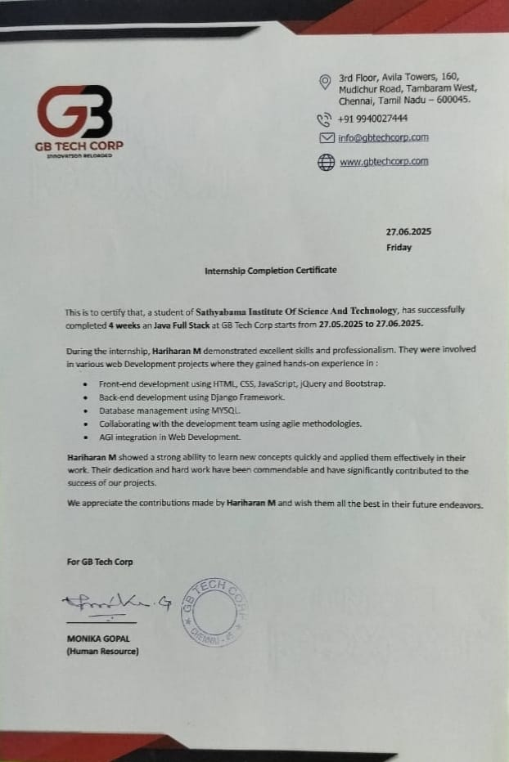
Internship offer letter & Certificate

Slide 3
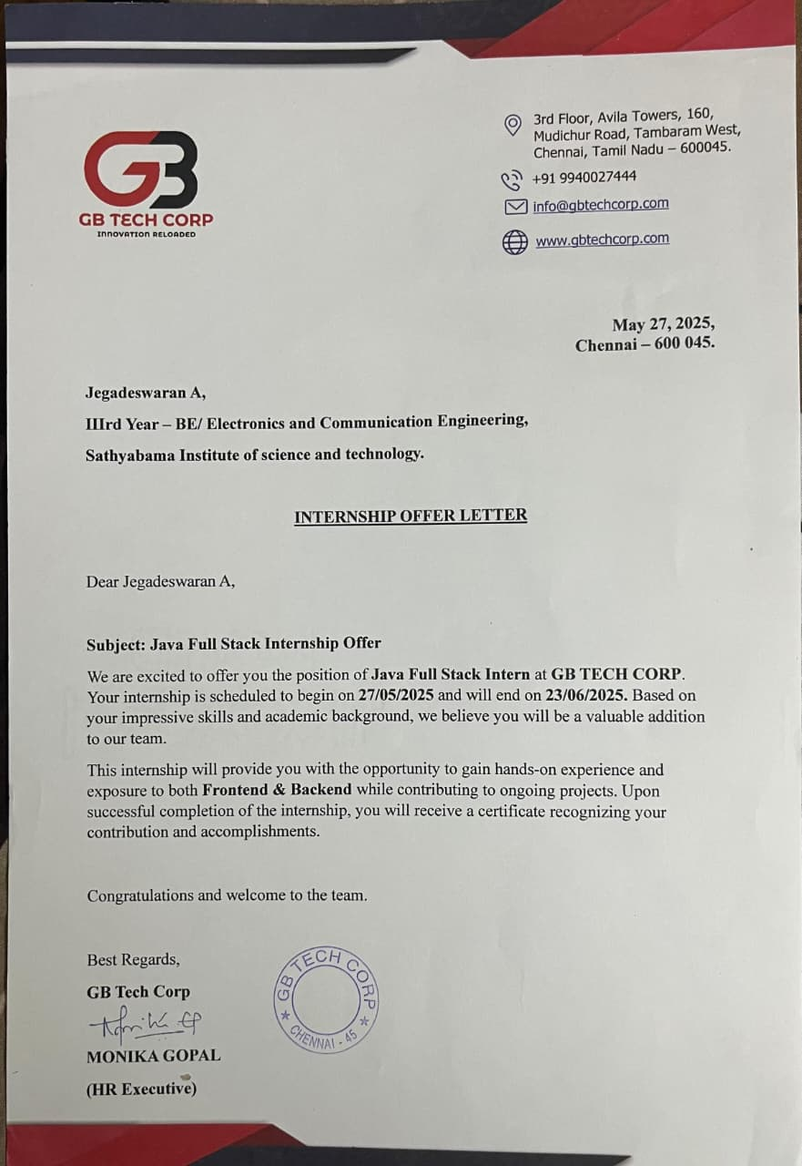
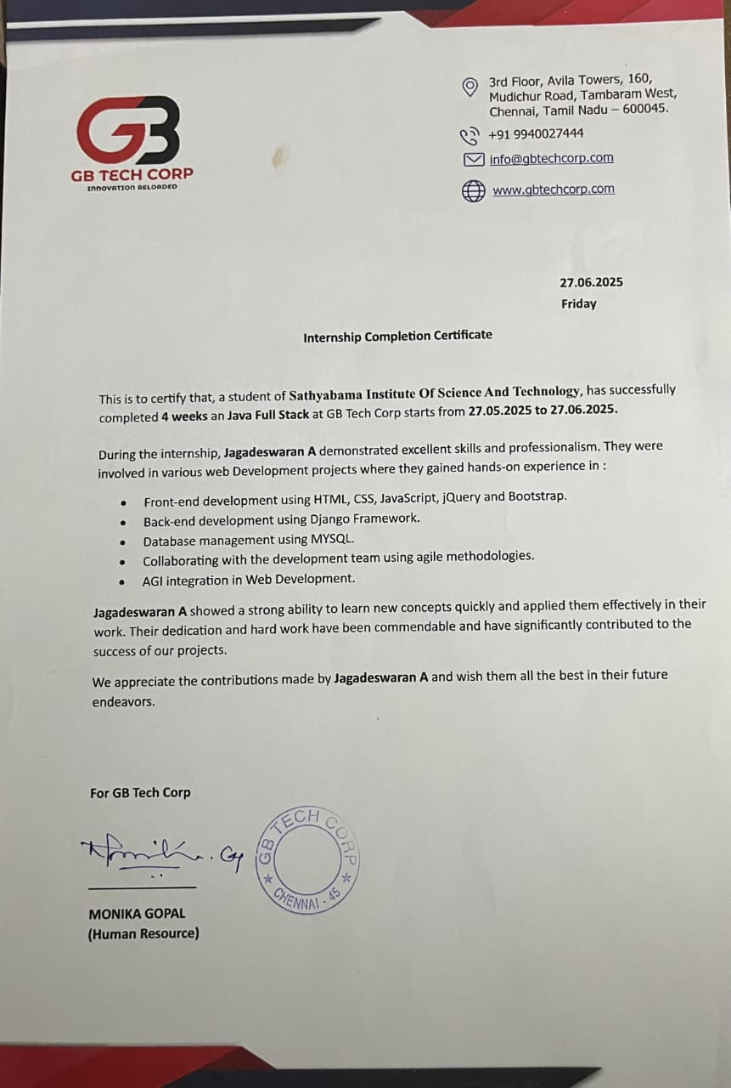

Slide 4
Objective of Internship
• To gain practical exposure in software development using Java and Spring Boot
• To understand backend application design and implementation
• To learn database integration and management with SQL
• To acquire knowledge of video streaming technologies like HLS protocol and FFmpeg

Slide 5
To bridge the gap between theoretical knowledge and real-world applications
• To improve problem-solving, coding, and debugging skills
• To gain experience in deploying applications using Tomcat server
• To build confidence for future IT placements through industry-level exposure

Slide 6
Internship project: Laptop Sales and Service Website
Initially, We started learning the basics of full-stack web development, focusing on both frontend and backend technologies. I explored HTML, CSS, and JavaScript for designing responsive user interfaces, followed by understanding server-side programming using Java and the Spring Boot framework.
To manage data effectively, I worked with MySQL for database integration and gained hands-on experience in designing entity relationships and writing SQL queries. I also learned to create RESTful APIs using Spring Boot, and understood the role of controllers, service layers, and repositories within a typical MVC (Model-View-Controller) architecture.

Slide 7
For project setup and build management, I used Spring Initializr and managed dependencies via the Maven pom.xml file. The project was hosted on the embedded Tomcat server provided by Spring Boot.
As part of this project, I developed an interactive web portal where users can:
Browse and filter laptops by brand, specifications, or price
Add laptops to a shopping cart and proceed with simulated payments
Book service appointments for repair or maintenance
Receive order confirmations and view service status updates

Slide 8
Outcomes achieved from this internship
Gained hands-on experience in Java, OOPs, and Spring Boot for backend development.
Built RESTful APIs using the MVC architecture with service and controller layers.
Designed and integrated a MySQL database using Spring Data JPA.
Developed responsive frontend using HTML, CSS, and JavaScript.
Connected frontend and backend through REST APIs.
Used Spring Initializr, Maven, and embedded Tomcat for project setup and deployment.

Slide 9
Implemented features like product catalog, shopping cart, and service booking system.
Improved skills in debugging, version control (Git/GitHub), and project structuring.
Understood full-stack development lifecycle through a real-world project.

Slide 10
Scope
The scope of this project is to design and develop a full-stack web application that facilitates the online sale and servicing of laptops. The system aims to provide an end-to-end solution where customers can:
Browse and purchase laptops based on brand, specifications, and price.
Book service or repair appointments for their devices.
Track orders and service status via a user-friendly interface.
The project includes the development of both the frontend (using HTML, CSS, JavaScript) and the backend (using Java, Spring Boot, MySQL). It also features an admin panel to manage products, services, and customer requests.

Slide 11
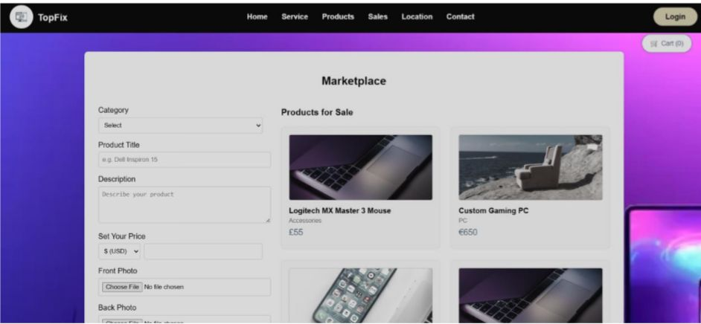

Slide 12
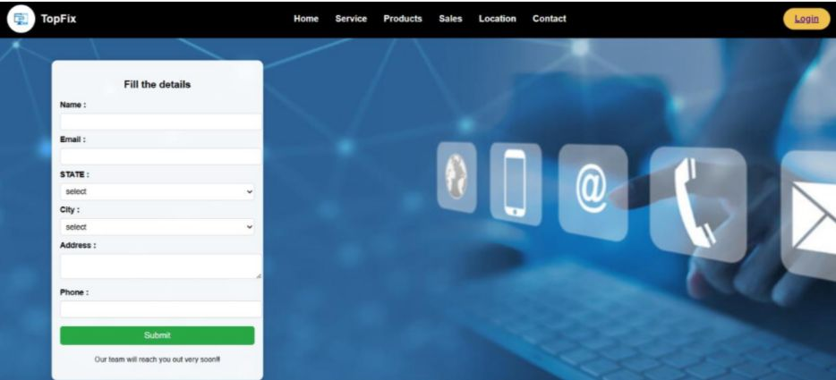

Slide 13
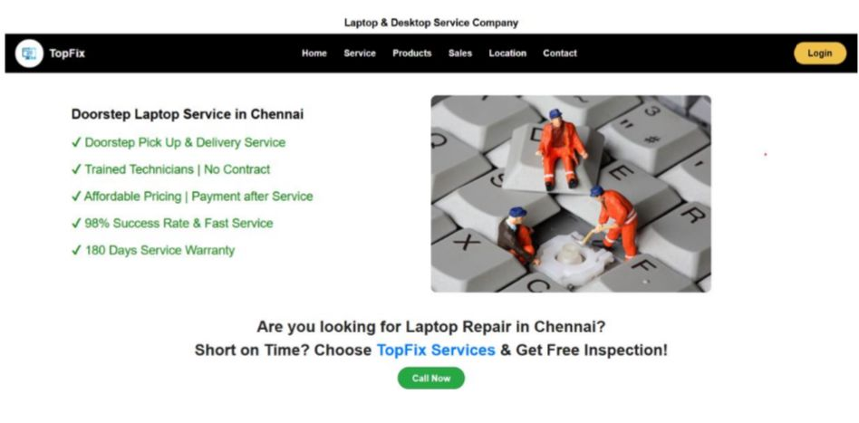

Slide 14
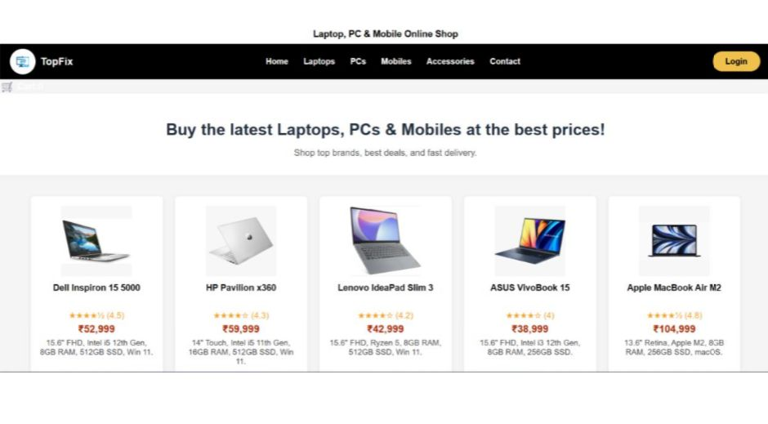

Slide 15




Conclusion & Gratitude
Internship bridged theory and practical skills
Thankful to mentors and team at GB Tech Corp
Looking forward to advanced roles in full stack development
Open to learning and future challenges

Slide 16
THANK YOU

